Slide 1
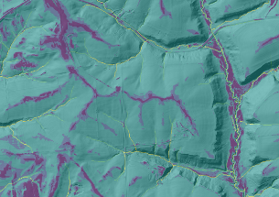
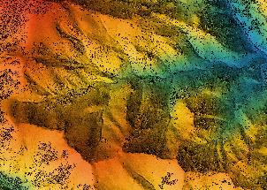


Dynamic Soils Hub Team Overview
Developers and Business
Notes:
Let the journey begin and cue up Steppenwolf. We are about to ignite the engines of the first warp drive. Together, we are boldly venturing into uncharted territories, where vision meets reality, and innovation propels us to new frontiers. Feel the thrill, embrace the adventure, and let this be our defining moment.

Slide 2
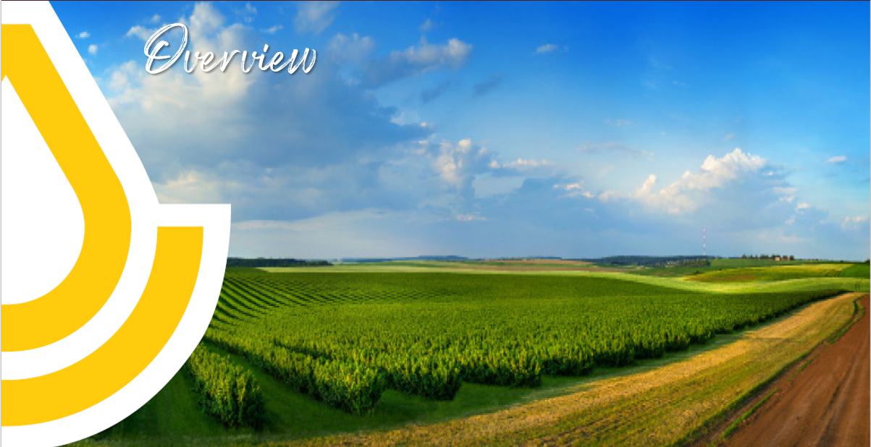
The Dynamic Soils Hub is a flagship innovation for scientists to model and report on soils data that change with conservation management.
Dynamic modeling user Interface
Notes:
The Dynamic Soils Hub is the torchbearer in the realm of soil science, revolutionizing how we model and report on soil data impacted by conservation management. It's not just a user interface; it's a portal to cutting-edge, dynamic modeling. The Hub’s mission is clear—crafting sophisticated models that elevate conservation efforts. While many of our existing models are decades old, the Dynamic Soils Hub breathes new life into our scientific capabilities, just in time. As the dead zone in the Gulf of Mexico expands and groundwater pollution escalates, we are tasked with a monumental challenge. Yet, through the Hub, we harness the latest scientific advancements, transforming billions invested in conservation planning into tangible conservation benefits. We stand at the precipice of unparalleled progress, ready to redefine what’s possible in conservation farming. This is not just an upgrade; it's a revolution, setting the stage for a future where our agricultural practices heal the earth and maximize food production in ways Hugh Hammond Bennett could only dream of.

Slide 3
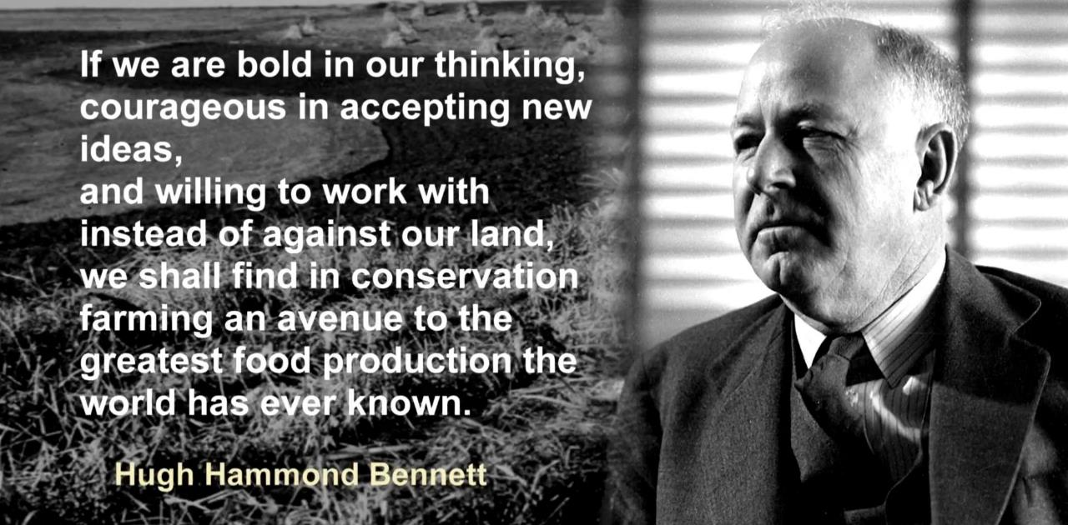
Science-Based Program Delivery
Notes:
Visualize, for a moment, standing at the dawn of a new era of soil conservation—a vision Hugh Hammond Bennett dreamed of. The Dynamic Soils Hub is not just a tool; it is the realization of Bennett's legacy, empowering us with scientific models and soil interpretations that transform conservation planning. In alignment with the Farm Bill’s emphasis on outcomes and conservation benefits, the Dynamic Soils Hub expands the USDA’s capacity to accurately model and report soil properties. These properties evolve with conservation management on a human timescale, providing real-time insights that make sustainable farming a reality. Let us be bold, unafraid to embrace innovative ideas, and work with nature instead of against it. Together, we will unlock the full potential of our land, leading to an era of conservation farming that surpasses all previous achievements in food production. This is not just progress; it is a revolution in the way we understand and interact with our environment.

Slide 4
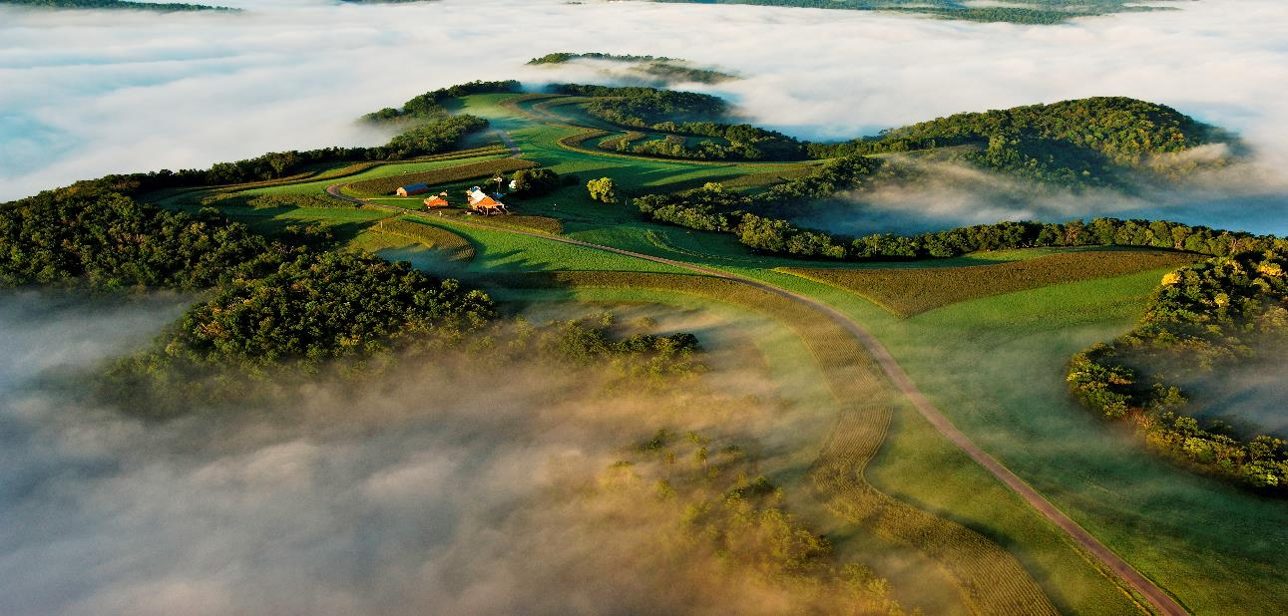
Supporting America’s Working Lands
On average, NRCS invests upwards
of $9 millions every day of the year
into conservation systems that help
producers stay profitable
and productive.
Notes:
The Dynamic Soils Hub is not just an innovation; it’s a monumental leap forward in conservation science, driven by the brilliant minds of our dedicated developers. Every day, NRCS invests upwards of $9 million into conservation systems, ensuring our producers remain profitable and our land stays productive. The Dynamic Soils Hub empowers us to build better models for Conservation Planning and conservation benefits, leveraging cutting-edge science to face contemporary challenges like the expanding dead zone in the Gulf of Mexico and rising groundwater pollution. It is through the tireless work of our developers that we can enhance these models, translating billions of dollars in investments into tangible, on-the-ground impacts. Together, we are not merely updating old models; we are forging a new path forward, making Hugh Hammond Bennett's vision of sustainable farming and superior food production a reality. This is the heartbeat of modern conservation, where technology and passion intersect to create lasting conservation change.

Slide 5
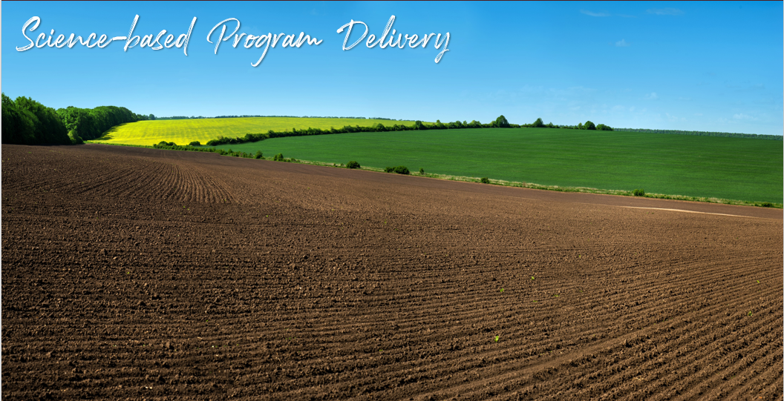
Farm Bill focus on outcomes and conservation benefits
Helping to support conservation program delivery
Notes:
USDA is required to provide “outcomes” and “conservation benefits” as outlined over 20 times in the 2018 Farm Bill. Some of these outcomes and benefits are dynamic soil properties Soil data is an underutilized treasure trove. It can be tapped for advanced geospatial model development that uses imagery, LIDAR, and other terrain analysis covariates. .
NRCS scientists who are charged with analysis and decision-support for leadership often lack access to the raw data and tools needed to visualize, validate, and approve information for leadership dashboards.
This provides qualitative and quantitative science-based foundation for conservation planning and program results
The Dynamic Soil Properties (DSPs) Hub is a flagship innovation that expands USDA capacity to model and report on soil properties that change with conservation management on a human time scale.

Slide 6
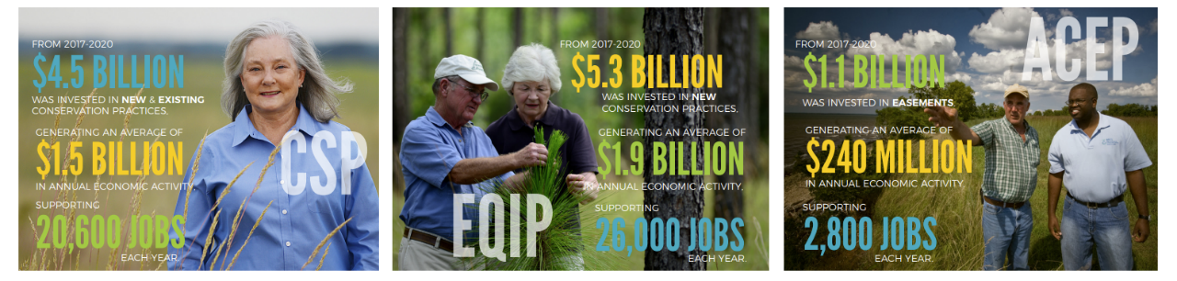
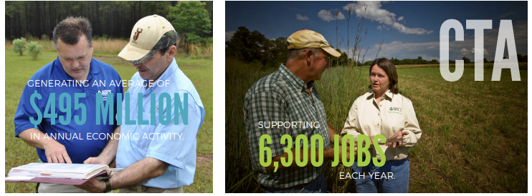
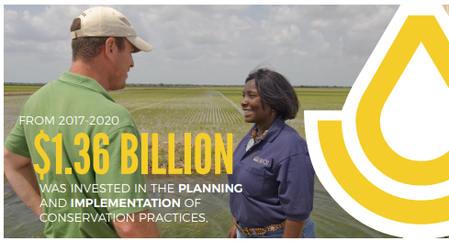
Helping People Help the Land
Notes:
The Dynamic Soils Hub is a testament to our commitment to conservation. The NRCS allocates a staggering $4-5 billion annually to advance conservation efforts. This slide illuminates the monumental impact of these investments, showcasing the breadth of jobs created and the vast economic impact. The Dynamic Soils Hub is the linchpin in this transformative era, ensuring that every dollar is utilized to its maximum potential. By harnessing the latest scientific advancements, our developers are paving the way for superior conservation models, directly contributing to more effective and efficient conservation on the ground. This is not merely an upgrade; it is a revolution, one that promises to deliver unprecedented conservation benefits and a sustainable future. The impact of your work is not just visible; it is profound and far-reaching. Together, we are not only fulfilling a vision; we are exceeding it, forging a legacy of conservation that will stand the test of time.

Slide 7

Innovation
Notes:
Our data is our past and our future. We have large data assets that need modernization and with new tools we can turn over a century of ground truthed data and new high-quality big-data into something more - a vast collection of fresh, granular, science-based geospatial information for critical national needs such as climate change and dynamic soils.
The DSP Hub includes high-performance geospatial modeling with specialized software such as PostgreSQL, PostGIS, SAGA and R Studio Server. This high-resolution terrain analysis enables science-based estimates of the impact of conservation practices on soil properties, such as soil carbon and other environmental benefits to prioritize, evaluate, and improve the conservation program delivery.

Slide 8

#Science
Notes:
It is an exciting time to be with NRCS as we are making excellent progress toward achieving our vision of once again becoming the best technical, science-based, planning organization across the land.
The hub expands USDA capacity to model and report on soil properties that change with conservation management. It will empower the collection, storage, and delivery of data related to dynamic soil properties and conservation management. The Hub will link soil and conservation databases, providing the ability to assess outcomes in conservation programs by accessing otherwise siloed data and models across Agency divisions
“Effects of conservation practices on soil properties” is another way to say, “environmental benefits” or “outcomes of conservation practices.”
• The DSP Hub is a feed to the CD/CART “Advanced Benefits Services.”
• The DSH Hub will establish data standards and a peer review process to embed a science-based foundation into conservation program and practice evaluation.
• Science, statistics, and careful data structuring, data stewardship, and model integration will provide high-quality, defensible (i.e., authoritative) estimates of environmental benefits.

Slide 9
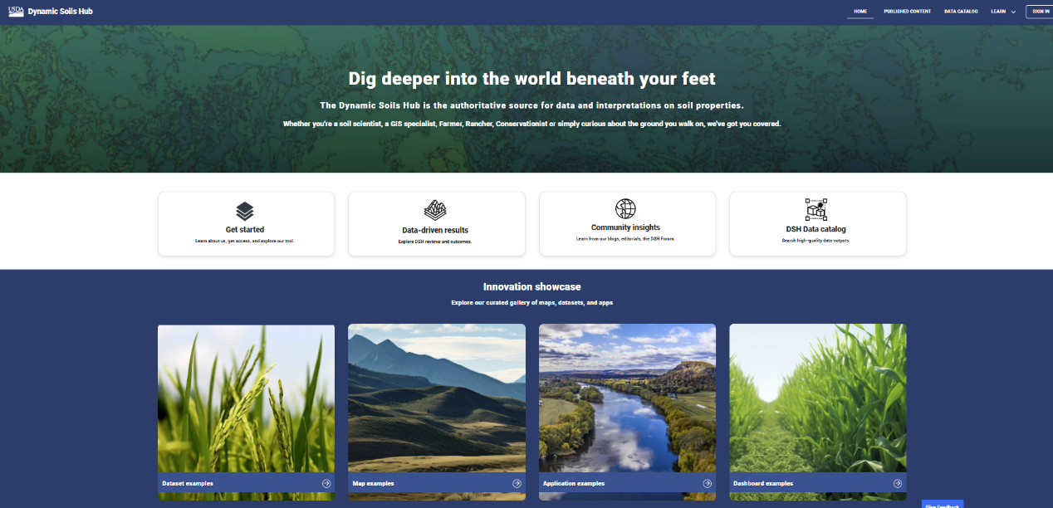
Building the Hub for Coders and Non-Coders
Notes:
The Dynamic Soils Hub is the pinnacle of versatility and innovation, designed for both coders and non-coders alike. Its adaptable, flexible structure offers multiple entry points, accommodating ever-evolving needs. By linking various applications, it accelerates data aggregation, indexing, and metadata generation, making it possible to save and share queries, R and Python scripts, and models effortlessly. The hub's drag-and-drop functionality and no-code approach are game-changers, allowing quick mockup creation without deep programming knowledge. This transparency and efficiency extend through the entire machine learning pipeline, empowering soil and data scientists to refine their models with ease. The Dynamic Soils Hub also ensures compliance with the Geospatial Data Act and the Evidence Act, making data accessible and usable. It’s more than a tool; it's a revolution in conservation science, saving time, eliminating pain points, and pushing the boundaries of what's possible. With this Hub, we are not just meeting the future; we are shaping it.

Slide 10


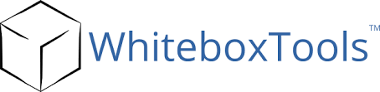









Application Open-Source Tools
The DS Hub is a flagship innovation for scientists to model and report on soils data that change with conservation management
Empowering technical and nontechnical scientists to create experiments with no coding experience
It is a game changer for data collection, storage & processing to support conservation program delivery
Notes:
As we forge ahead with the Dynamic Soils Hub, we are driving NRCS into a new era of scientific excellence. Using a diverse and powerful toolset, we’re building this dynamic modeling platform on the AWS GovCloud with RedHat and Ubuntu OS. We are pioneering at NRCS by using Mapserver and REACT to automate compliance with the Geospatial Data Act 19115, making data discoverable through rich metadata through our UX Data Catalog. Using Python and R for our analytic APIs within our React application, GRASS, SAGA, and Whitebox for terrain analysis, and MapServer for handling layers, we are pushing the boundaries of what’s possible. Transitioning to Postgres and PostGIS for geospatial data marks a significant leap from our longstanding PSQL Server infrastructure. The Dynamic Soils Hub is a flagship innovation, empowering both technical and nontechnical scientists to create experiments with no coding experience. It is a true game changer for data collection, storage, and processing, amplifying our ability to support and enhance conservation program delivery. Together, we are setting the stage for groundbreaking advances in soil science and conservation, turning bold ideas into powerful realities.

Slide 11
Dynamic Soils Hub (DS Hub) Overview
Picture a realm where cutting-edge technology meets conservation stewardship. We are at the forefront of this revolution, building Dynamic Modular Tools that seamlessly connect diverse data sources.
Our high-capacity geospatial capabilities and workflow automation are transforming how we visualize data, offering real-time insights that were once the stuff of dreams.
With unparalleled access to large datasets, we are not just addressing inefficiencies; we are eliminating pain points, saving time, and paving the way for more effective conservation practices.
Dynamic Modular Tools
Workflow Automation
Connecting Data Sources
Data Visualization on the Fly
High-Capacity Geospatial
Access to Large Datasets
Notes:
Picture a realm where cutting-edge technology meets conservation stewardship. We are at the forefront of this revolution, building Dynamic Modular Tools that seamlessly connect diverse data sources. Our high-capacity geospatial capabilities and workflow automation are transforming how we visualize data, offering real-time insights that were once the stuff of dreams. With unparalleled access to large datasets, we are not just addressing inefficiencies; we are eliminating pain points, saving time, and paving the way for more effective conservation practices. This is the future of conservation planning—powerful, impactful, and exhilarating. The Dynamic Soils Hub is not just a tool; it is a game-changer, poised to redefine the landscape of conservation science and conservation.

Slide 12
Goals
GIS Big Data Processing
Data Model Change control based on the NASIS system
Implement Mathematics, Fuzzy Logic Model Reasoning
Publishing data externally and internally to states
Address Compliance Issues, Infrastructure Updates
Session Management– Persistence/ Common Libraries
Health Checks/Best Practices
Workflow management and QA Code Checks
Data Catalog (GDA)
Machine Learning and Geospatial scalability

Slide 13








Example Workflow
LOAD DATASETS
SSURGO
R-FACTOR
3M ELEVATION
CREATE A MODEL
PUBLISH THE MODEL
K-FACTOR
R-FACTOR
LS FACTOR
STREAM ORDER
USE THE MODEL IN A CONSERVATION APPLICATION
NUTRIENT RUNOFF VULNERABILITY
(R*K*LS)+ STREAM ORDER
CONSERVATION APPLICATION
Notes:
Envision the power in your hands with the Dynamic Soils Hub. This isn't just a tool; it's a game-changing innovation built for both coders and non-coders, revolutionizing how we model and report on soils data influenced by conservation management. NRCS scientists often find themselves hampered by a lack of access to raw data and the necessary tools to visualize, validate, and approve critical information for leadership dashboards. The Dynamic Soils Hub changes this paradigm.
By collaborating with data stewards, we're constructing high-capacity geospatial data pipelines at a national scale, giving soil scientists access to preprocessed and pre-vetted large datasets, so they can focus on what truly matters—the science. With our hub’s powerful system, NRCS soil scientists are no longer limited by processing power. The Dynamic Soils Hub streamlines their workflow, automates processes, and provides dynamic modeling tools that enhance efficiency and accuracy.
With the ability to connect to numerous data sources, visualize data on the fly, and share models seamlessly, the hub transforms conservation planning and management. It responds swiftly to requests for science-based soil property data from leadership, supporting NRCS's mission: "Help the people help the land." Your work in developing this hub isn’t just about improving tools; it’s about empowering scientists to achieve unprecedented levels of efficiency and impact, shaping the future of conservation science. This is the revolution we've been waiting for, a leap towards a sustainable future

Slide 14
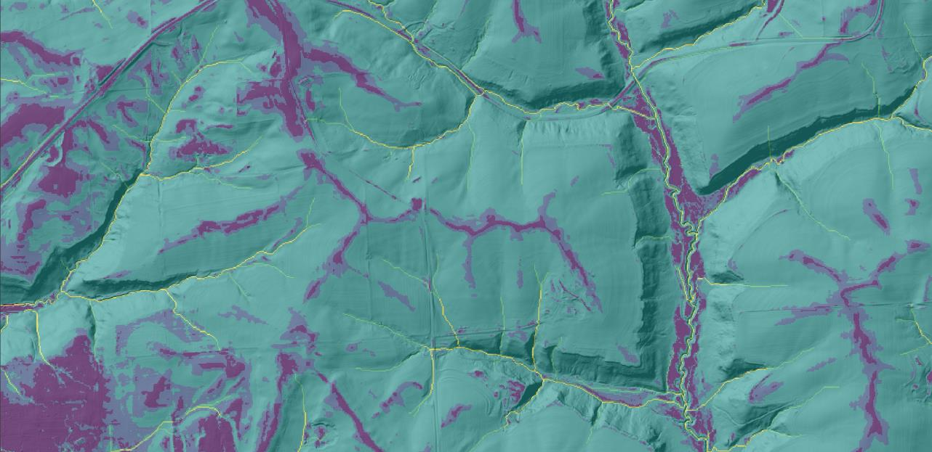
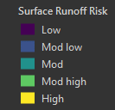
Nutrient Runoff Vulnerability Model
Notes:
Witness the future of conservation in action through the Dynamic Soils Hub. Here, scientists are empowered to create nutrient runoff vulnerability models using high-resolution 3-meter elevation derivatives. These models exemplify our commitment to precision and innovation, highlighting areas at risk for soil nutrient loss due to surface water erosion. By identifying steep slopes, preferential flow paths, and vulnerable soil types, we are not just predicting outcomes but paving the way for proactive soil conservation strategies.
Conceptualize the power of this data, combined with our versatile toolset—dynamic modular tools, real-time data visualization, and high-capacity geospatial analysis. This is the essence of the Dynamic Soils Hub: a platform where cutting-edge science meets practical application, transforming every dollar of our $4-5 billion annual investment into real-world impact. This is the revolution in conservation planning that will leave you breathless, as we bring Hugh Hammond Bennett’s vision into the modern era.

Slide 15
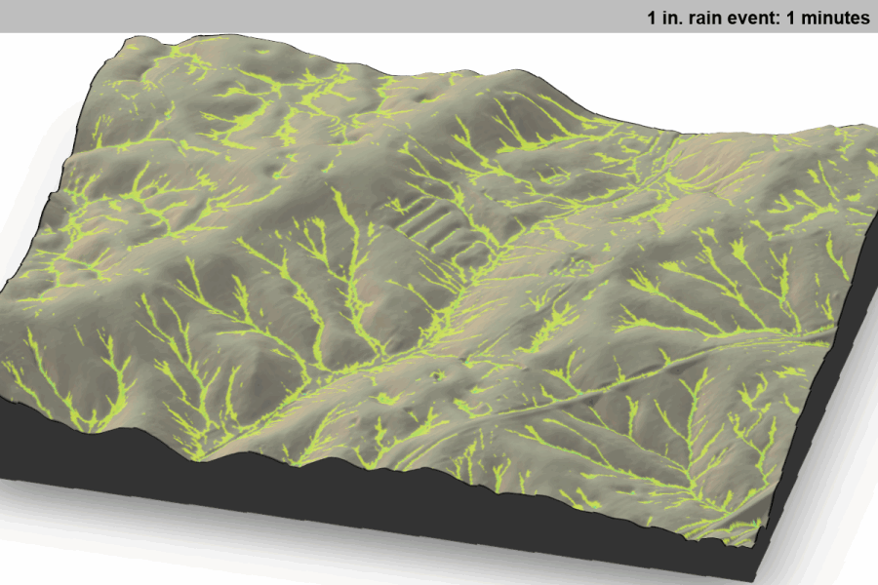
Example of a model on the Hub
Criteria on:
High-performance computing
Support users with strong backgrounds in:
soil science
field & lab measurement
GIS/statistics/database
communication/visualization
10x-100x field/lab measurements of soil hydraulic properties:
saturated hydraulic conductivity
water retention curve
soil structure
rock fragment volume
organic matter content
more detailed terrain data
more above/below ground monitoring stations like SCAN/SNOTEL
more accurate gridded rainfall data
Notes:
With the Dynamic Soils Hub, we are doing just that—supporting users with strong backgrounds in soil science, field and lab measurements, GIS, statistics, databases, and visualization. We're pushing the envelope with 10x-100x more detailed field and lab measurements of soil hydraulic properties, terrain data, and monitoring stations like SCAN and SNOTEL.
Building these models is no easy feat. We rely on 3-meter elevation data and its derivatives, a staggering 30-40 TB for just one set, necessitating localized data for optimal performance. This has led us to use PostgreSQL for scalable solutions, bypassing the limitations of REST services. The Dynamic Soils Hub empowers scientists to create and share model APIs that seamlessly integrate into applications like Conservation Desktop, making sophisticated conservation planning a reality.
We are transcending static soil surveys by incorporating dynamic data sources, precip and temp, and terrain information. Our efforts enable accurate terrain analysis and water flow mapping, ensuring every conservation practice is informed by the best science available. The Dynamic Soils Hub is more than a tool; it's a transformative platform, ensuring NRCS's mission—"Help the people help the land"—is not just upheld, but advanced to new heights. This is conservation innovation at its finest, setting the stage for unprecedented scientific achievements and conservation stewardship.

Slide 16
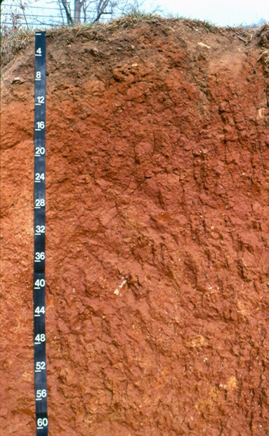
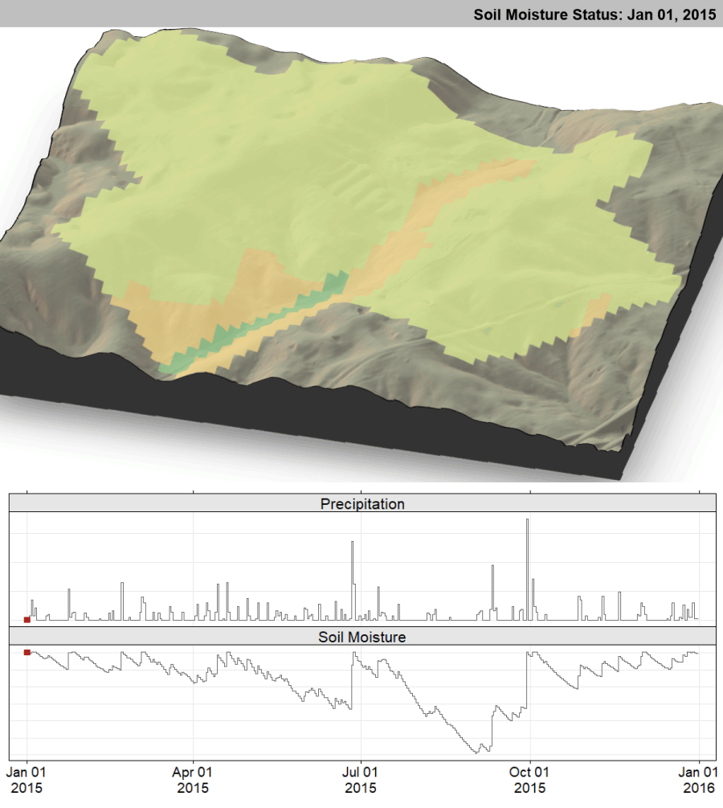
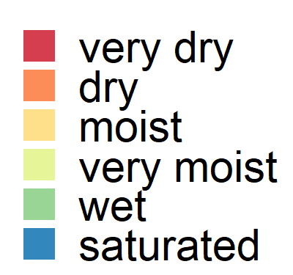
Dynamic Soil Survey
Notes:
Now, let's dive into the profound impact of dynamic soil survey products. The right image showcases a soil profile, a testament to a soil scientist’s expertise in describing, classifying, and mapping. When combined with real-time precipitation data, we can predict the soil moisture status and other dynamic soil properties. The Dynamic Soils Hub allows us to develop simulation models that forecast soil properties and interpretations under varying management systems—addressing a longstanding challenge. This ensures the relevance of soil information beyond static ranges recognized in NASIS/SSURGO, by accounting for the effects of management. The future demands an understanding of how dynamic soil and vegetation properties change over time and how they can be managed sustainably. With the Dynamic Soils Hub, we aren’t just keeping pace; we’re leading the charge towards a more sustainable and scientifically robust future.

Slide 17
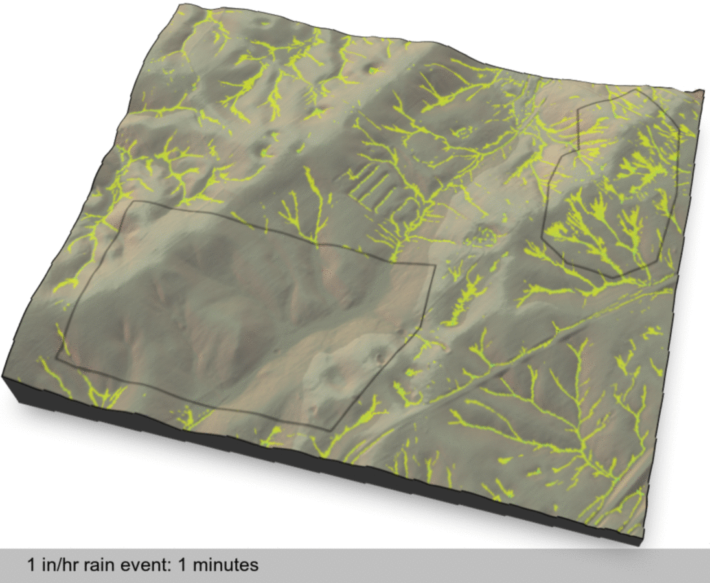
lower
infiltration rates
higher
infiltration rates
significant runoff
ephemeral stream
Credit: Dylan Beaudette
Notes:
This is the ultimate goal of what we want for our planners. To help make better planning decisions. Our goal is to build tools and apps that can be put into one place.

Slide 18
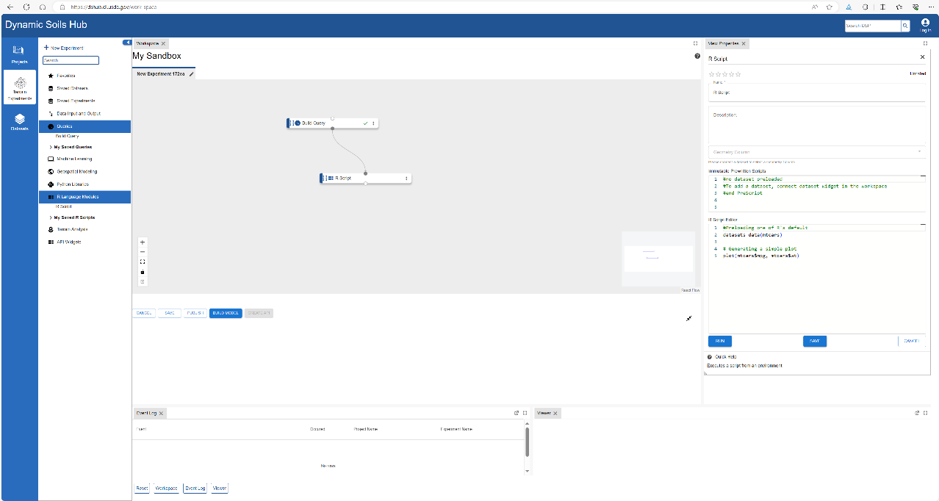
Creating Interpretations with R

Slide 19
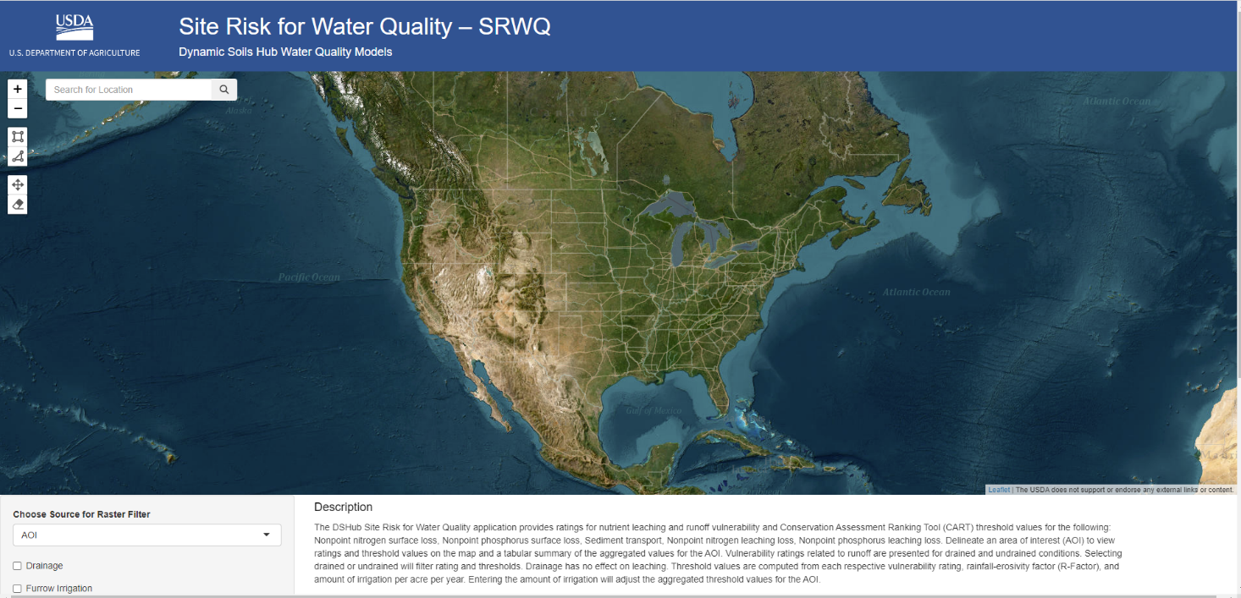

Slide 20
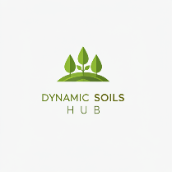
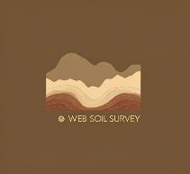
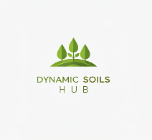
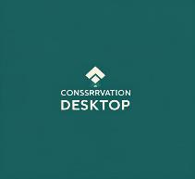
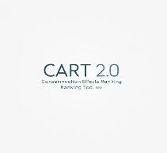
Product Delivery
The Dynamic Soils Hub is an advanced platform that integrates data visualization, dashboards, and a product builder for scientific model creation.
Public Data Catalog and Apps
Delivery authoritative data to
Web Soil Survey
Data delivery, GDA data catalog, public apps and visualization
Web Soil Survey aggregation engine, soil thematic and soil interpretation delivery
Models for connecting risk factors for resource concern to functional pathways
Notes:
The Dynamic Soils Hub stands as a beacon of innovation and progress in soil science. This cutting-edge platform seamlessly integrates data visualization, dynamic dashboards, and a robust product builder for scientific model creation. Delivering authoritative data to the Web Soil Survey, the Hub also facilitates data delivery through the GDA data catalog, public applications, and visualization on the Dynamic Soils Hub Public Pages. By leveraging the Web Soil Survey aggregation engine, it enhances soil thematic and interpretation delivery, seamlessly integrating with Conservation Desktop.
Moreover, the Hub is paving the way for the next generation of the Conservation Assessment Ranking Tool (CART 2.0), connecting risk factors for resource concerns to functional pathways. This comprehensive integration supports informed decision-making in soil and plant science, driving efficiency and innovation. The Dynamic Soils Hub is not just a platform; it’s a revolution in soil data analysis and management, ensuring that every step taken is a step towards a more sustainable and scientifically informed future.

Slide 21


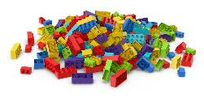
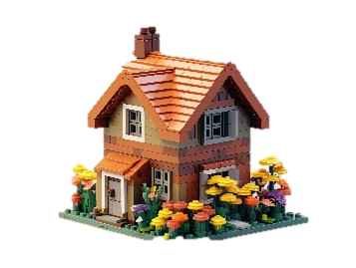
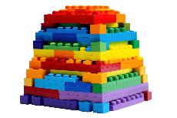
GEOSPATIAL MODELING
Where We Are Located
The DS Hub is a lake house within a data lake called Enterprise Data Analytics Platform & Toolset (EDAPT)
EDAPT (Enterprise Data Analytics Platform & Toolset) is considered part of the Office of the Chief Information Officer (OCIO), meaning it falls under the responsibility of the agency's Chief Information Officer and is used for managing and analyzing data across various departmental systems)
DATA LAKE “EDAPT”
OCIO AWS GOVCLOUD
STRUCTURED DATA PIPELINES
GIS DATASETS, SOIL (NASIS SYSTEM) AND
CONSERVATION DATABASES (CART AND CD)
LAKE HOUSE
DYNAMIC SOILS HUB ENVIRONMENT
HUB UI/UX FINAL DATA PRODUCTS
Notes:
The Dynamic Soils Hub is more than just a tool; it is a key component within the broader Enterprise Data Analytics Platform & Toolset (EDAPT). Positioned as a 'lake house' within this expansive data lake, the Hub taps into structured data pipelines, GIS datasets, soil information from the NASIS system, and conservation databases like CART and CD. This integration not only facilitates advanced geospatial modeling but also enhances UI/UX for final data products. Under the stewardship of the Office of the Chief Information Officer (OCIO), EDAPT underscores the Hub's role in managing and analyzing data across diverse departmental systems. Our mission is clear: to provide a seamless, comprehensive platform that supports impactful conservation efforts. This slide visualizes our strategic positioning within EDAPT, showcasing how the Dynamic Soils Hub connects various data sources and tools to deliver powerful, actionable insights. It's a testament to our commitment to innovation, efficiency, and excellence in soil and conservation science.

Slide 22
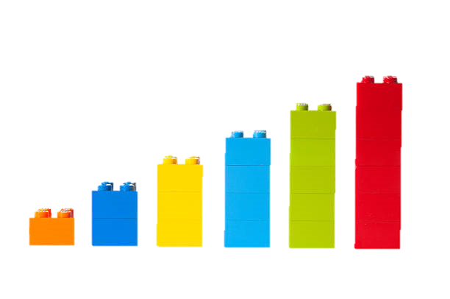


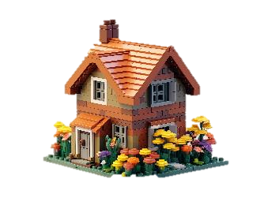

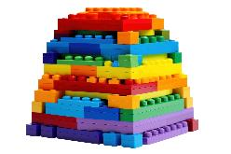
Database Pipeline Vision Process
DS HUB DATABASES (POSTGRES)
DISC NRCS DATABASES (SQL SERVER)
AWS FPAC COMMERCIAL
UNSTRUCTURED DATA LAKE “EDAPT”
AWS OCIO GOVCLOUD
DATA LAKE HOUSE
DYNAMIC SOILS HUB ENVIRONMENT
DYNAMIC SOILS HUB
DATA MODEL CHANGE CONTROL DEPLOYED SCHEMAS
STRUCTURED DATABASE DESIGNS
DATA MODEL CHANGE CONTROL
SCHEMAS, STANDARDS AND DEPLOYMENT
STRUCTURED DATA PIPELINES
GIS DATASETS, SOIL (NASIS SYSTEM) AND
CONSERVATION DATABASES (CART AND CD)
Notes:
Dream about building our future of soil science and conservation one Lego block at a time. This is our vision embodied in the Dynamic Soils Hub data pipeline. Picture the sequence: DISC NRCS Databases (SQL Server) form the base, paving the way for AWS FPAC Commercial’s Unstructured Data Lake "EDAPT." Next, we move to the AWS OCIO GovCloud, the Data Lake House where the Dynamic Soils Hub thrives. Here, DS Hub Databases (Postgres) and our Dynamic Soils Hub Data Model Change Control orchestrate deployed schemas and structured database designs.
From structured data pipelines to GIS datasets and soil information (NASIS system), to conservation databases (CART and CD), each Lego block interlocks seamlessly. This construction isn’t just about stacking data; it’s about creating a robust and adaptable platform that empowers us to address the complexities of soil conservation with precision and agility. This vision isn’t merely a technical feat; it’s a testament to our commitment to harnessing the power of data to revolutionize conservation efforts. It’s a dynamic, ever-evolving structure that pushes boundaries and drives us toward a sustainable, scientifically-backed future.

Slide 23
Business
Jason Nemecek – Dynamic Soils Hub Business Owner
Notes:
This slide introduces key personnel involved in the Dynamic Soils Hub. Jason Nemecek is the Application Owner for the Dynamic Soils Hub, responsible for guiding the development and management of the application to meet user needs and deliver impactful results. Jason's vision for the Dynamic Soils Hub is to create a cutting-edge platform that revolutionizes soil data management, modeling and conservation planning.

Slide 24
Teams Overview
Overview
The Hub is the new integrated approach spanning multiple Odin teams to provide a consistent and integrated solution for delivering soil and conservation data products to both internal and external customers. The Hub covers the concept of the Dynamic Soils (DS) Hub and Conservation Geo to avoid duplication of functionality and maximize integration.
Approach
A one-product approach across teams will ensure consistency in data, products, and services
Integration between teams through:
dedicated senior resources that cut across teams
regularly scheduled team integration meetings
multi-team collaborations
Any team can theoretically take on any feature within approved program epics, and specialized skills can be shared across teams as needed. While teams may develop expertise in certain areas, we aim to avoid restricting any team to specific topics. Teams can be responsible for either Program Epics or Features. However, there will be a single Jira component for the Portfolio Epics (DSH) that all teams will link to, and teams will have micro roadmaps to contribute collectively.
Notes:
Dynamic Soils Hub as a meticulously constructed Lego masterpiece, where each block represents a vital component in our innovative soil and conservation data ecosystem. This integrated approach spans multiple DS Hub teams on the Odin train, ensuring a seamless and consistent delivery of data products to both internal and external customers. By combining the strengths of the Dynamic Soils Hub and Conservation Geo, we eliminate redundant functionalities and maximize integration, creating a unified, powerful solution.
Our one-product strategy across teams guarantees consistency in data, products, and services. This is achieved through dedicated senior resources, regular integration meetings, and multi-team collaborations. This cohesive framework allows any team to tackle any feature within approved program epics, with specialized skills shared as needed. Whether developing expertise in specific areas or contributing to Program Epics or Features, each team plays a crucial role in our collective mission.
With a single Jira component for Portfolio Epics (DSH) and micro roadmaps that guide us, we are building a future where our integrated efforts lead to groundbreaking advancements in soil science and conservation. This collaborative vision is not just about achieving goals; it’s about creating a legacy of innovation and excellence that will inspire and elevate our mission for years to come.

Slide 25
Team Breakdown
Application and Widget Development (Query Builder, UI)
Publishing automation and Public Pages
Albacore
Horizon
Sea Shadow
Seawolf
Artemis
Apollo
Ceres Tiger Team
Phoenix
Geospatial services integration
Services Inventory System for Geospatial Data Act Compliance
Create Geospatial Data Delivery Pipelines for Publishing Approved Data
Establish S3 buckets and delivery system automations
Advanced Modeling and Simulation Capabilities in DS Hub UI
Data Visualization and Analysis
Develop Data Model Change Control System
Create Data Designs, Data Marts, Data Catalog for Storing and Managing Data
DevOps
Best Practices
Import and Process Geospatial Data into Authoritative Data Sources
Error Handling and Integration
Soil/Conservation Data Request and Release Workflow Tool
Integration of Roles and Publishing Workflows
Notes:
At the heart is Albacore, championing DevOps and best practices. Surrounding it, Horizon drives application and widget development, with a focus on query building and UI, as well as publishing automation and public pages.
Sea Shadow forges geospatial data delivery pipelines, establishing S3 buckets and delivery automations. Sea Wolf meticulously develops the data model change control system, creating data designs, marts, and catalogs for storing and managing data. Apollo handles soil and conservation data requests and release workflows, integrating roles and publishing workflows with precision.
Artemis imports and processes geospatial data into authoritative sources, managing error handling and integration. Phoenix brings advanced modeling and simulation capabilities to the DS Hub UI, excelling in data visualization and analysis. And now, the Ceres Tiger team seamlessly integrates geospatial services, with a Services Inventory System ensuring compliance with the Geospatial Data Act.
Together, these teams form a cohesive unit, each playing an essential role in building a revolutionary platform that transforms soil data management and conservation scientific models, one block at a time.

Slide 26
Overview – Team Core Focus Areas
Horizon
Application and Widget Development (Query Builder, UI)
Publishing automation and Public Pages
Phoenix
Advanced Modeling and Simulation Capabilities in DS Hub UI
Data Visualization and Analysis
Artemis
Import and Process Geospatial Data into Authoritative Data Sources
Error Handling and Integration
Apollo
Sea Shadow
Sea Wolf
Albacore
Soil/Conservation Data Request and Release Workflow Tool
Create Geospatial Data Delivery Pipelines for Publishing Approved Data
Develop Data Model Change Control System
Database Systems and DevOps Management, Integration across teams
Geospatial services integration
Ceres Tiger Team
On-Demand Processing for Curated Results (API Switchboard)
Integration of Roles and Publishing Workflows
Establish S3 buckets and delivery system automations
Create Data Designs, Data Marts, Data Catalog for Storing and Managing Data
Services Inventory System for Geospatial Data Act Compliance
Notes:
This sorted list provides another perspective on how each team contributes to building a revolutionary platform that transforms soil data management and conservation planning, block by block.

Slide 27

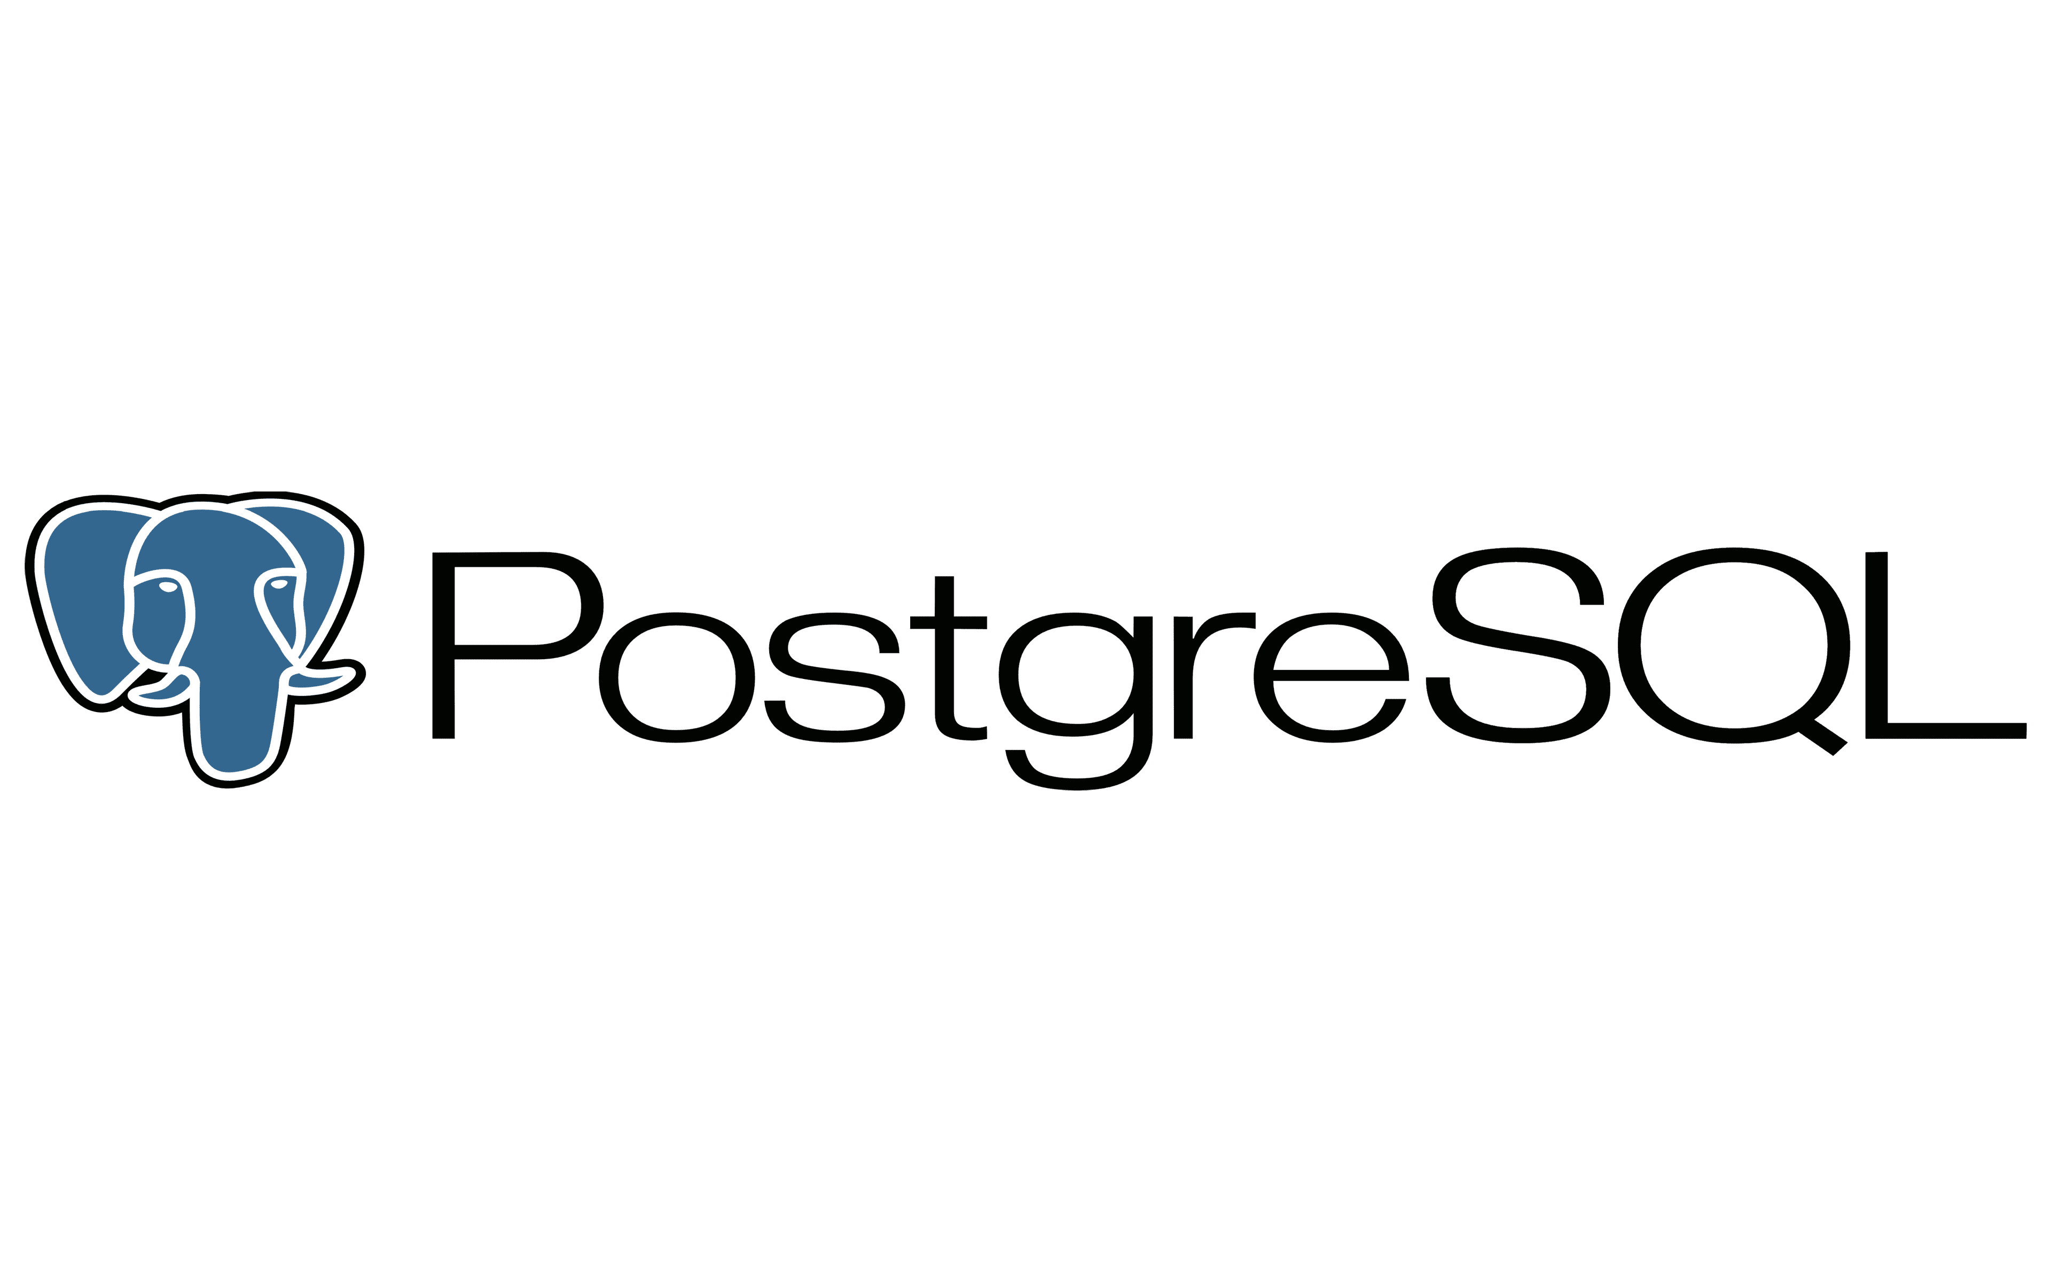







Horizon
Team Description
The Horizon development team within the Dynamic Soils Hub system is dedicated to shared application development, with a high focus on enabling users to build queries and then models applying retrieved data to their experiments and projects using different types of widgets (parameter, geospatial, etc.), scripts, and queries using the Jupyter Hub, pSQL, and Python and R programming languages. Additionally, Horizon focuses on customer experience within the hub by building out and managing public accessible pages so that visiting users will be able to learn about the Dynamic Soils Hub without authentication, an admin dashboard where authenticated users can manage roles and permissions, and user preference settings to allow for users to select their personal preferences in their view of the hub. The leadership on the team is highly technical and experienced in geospatial modeling and open-source architecture, enhancing the DSHub application and geospatial modeling environment and tools.
Program Roadmap
Key milestones
Query Builder user functionality (Jan ’25)
Geospatial Widget (Jan '25)
Publishing Phase 1 (Apr ‘25)
Parameterization (Apr ’25)
Public Pages (Jul ’25)
Data Model Change Control (Jul '25)
Critical deliverables
R/Python Script Widget
Geospatial Raster Vector operations in UI
Query Builder operations
PI28: Integrate Notebooks + Geospatial Widgets
Oct ‘24 – Jan ‘25
PI29: Publishing, Parameterized Queries + Widget Connects
Jan – Apr ’25
P30: Public Pages, Data Model Change Control + User Preferences
Apr – Jul ‘25
Technology
Notes:
Fun Fact – Horizon Name - Horizon is named after the way that soil forms in layers called horizons and the "New Horizons" and "New Frontiers" NASA programs to explore and understand the solar system

Slide 28






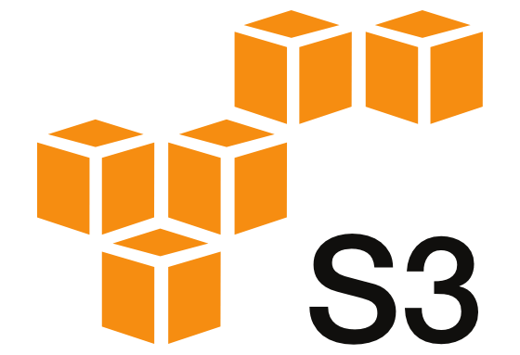
Artemis
Team Description
The Artemis Development Team within the Dynamic Soils Hub Environment plays a crucial role in shared application development and automation of geospatial products.
The team focuses on automating processes that harvest geospatial data from transactional systems to produce relevant information and products that are delivered to internal and external outlets while ensuring and incorporating quality assurance.
Their technical leadership encompasses data pipeline automation that will establish standardized systems optimized for data loading, model integration, and efficient delivery of data and products.
Team Artemis is integrating various internal and external datasets, including NPAD, ProTracts, Common Land Units, and elevation derivatives.
Program Roadmap
Key milestones
Deliver Workload analysis data requests (Nov ’24)
Deliver quarterly KPI results (Jan, Apr, July ‘25)
Deliver ConGeo data to state stakeholders (Jan , Apr, Jul ‘25)
Modernize Data Model to address financial, Practice implementation and Status group questions (Jan ‘25)
Modernize Data Model to address Resource & conservation Concerns group questions (Apr ‘25)
Modernize Data Model to address Geospatial Analysis group question (Jul ‘25)
Data Visualization POC to learn User Behavior (Apr 25)
Soil Map Unit Summaries (Apr 25)
Critical deliverables
• KPIs , ConGeo (Ad-hoc: WLA, GHG)
• Map Unit Summaries, SHAPE, Water Balance for Engineers, Site Risk for WQM Resource & conservation Concerns
Critical deliverables
PI28:KPIs + ConGeo (Financial, Practice Implementation and Status )+ POC Data Model + Define QA Processing
Oct ‘24 – Jan ‘25
PI29: •Data Visualization POC + Map Unit Summaries + Data Model + ConGeo (Resource & conservation Concerns ) + Automate QA process
Jan – Apr ’25
PI30: •ConGeo (Geospatial Analysis) + SHAPE + Water balance for Engineers + Site Risk for WQM
Apr – Jul ‘25
Technology
Notes:
Fun Fact – Artemis Name - Artemis is the goddess of conservation - also the name chosen by NASA for the next moon landing missions

Slide 29

Seawolf
Program Roadmap
Key milestones
Core Data Model 1.0 (Dec ‘24)
Database Go-Live (Jan ’25)
Front End Data Catalog enhancements (Mar ’25)
GDA Compliance (Apr ‘25)
Data Model Change Control (Jul '25)
Critical deliverables
Data Catalog + Model Change Control
Metadata Framework
Enterprise Data Warehouse
Completed Front End Data Catalog
Team Description
The Seawolf Development Team within the Dynamic Soils Hub Environment is pivotal in managing enterprise data, focusing on data warehousing and data modeling, including the development of a comprehensive data catalog. They are tasked with building a data model change control system akin to the NASIS data model change control system, ensuring robust governance and version control. Their responsibilities include developing the data catalog, establishing enterprise data warehousing (data marts), and creating a Data Catalog UI. Additionally, they will finalize the metadata and data catalog data model, along with the data model change control system.
PI28: Data Model + Infrastructure
Oct ‘24 – Jan ‘25
PI29: Integration + GDA Framework
Jan – Apr ’25
PI30: Scale + Production Release
Apr – Jul ‘25
Technology
Notes:
Fun Fact – Seawolf Name - The Seawolf class is a class of nuclear-powered, fast attack submarines (SSN) in service with the United States Navy. Seawolf-class submarines are larger, faster, and significantly quieter than previous Los Angeles-class submarines; they also carry more weapons and have twice as many torpedo tubes.

Slide 30

Apollo
Team Description
The Apollo Team’s purpose within the Dynamic Soils Hub Environment is creating a seamless UI/UX experience while managing complex workflows and quality assurance tools. They aim to establish a robust business process for handling customer data requests, ensuring the collection of necessary data for the GDA (data catalog and reporting) and metadata. This process is governed by a roles and rules engine, integrated into the databases to maintain control and security. Technical leadership is centered around business workflows, data governance roles, and process intake, utilizing tools like the AWS Rules Engine for publishing workflows and rules.
Program Roadmap
Key milestones
Process Map & Roles Definition (Dec ‘24)
Initial Workflow Implementation (Mar ‘25)
Publishing Framework Complete (Jun ‘25)
Critical deliverables
Process Map & Governance Framework
Data Request & QA Workflow Tool
Publishing & Release Management
Metadata Integration with Seawolf
PI28: Process Design + Discovery
Oct ‘24 – Jan ’25
PI29: Workflow Implementation
Jan – Apr ’25
PI30: Release & Integration
Apr – Jul ’25
Governance Role Definition – CX Research & Journey Mapping – Initial UI/UX Design Exploration
Initiate build of Request Management System – QA/QC Framework – Role Based Access Control (RBAC)
Data Release Framework – Security Review Integration – Seawolf Catalog Integration
Technology
Notes:
Fun Fact – Apollo Name - Apollo is the twin brother of Artemis and the name chosen by NASA for the first moon landing missions

Slide 31
User-Centric Foundation
Current Focus
PI28
Establishing core user experiences and workflows for data governance
User Experience & Journey Design | Stakeholder Communication
Define comprehensive user journeys and role-based workflows | Enable effective communication between data stakeholders
Key connections
Horizon Seawolf Sea Shadow | All teams Horizon

Slide 32
Technical Architecture and Security
In-Progress
PI28-29
Building secure and scalable data governance infrastructure
Data Governance Architecture | Authentication & Authorization
Design a scalable architecture for workflows and approvals | Implement role-based access control framework
Key connections
Albacore Seawolf Artemis | All teams Albacore

Slide 33
Data Management and Automation
Planned
PI29-30
Implementing automated workflows and data catalog integration
Data Catalog Integration | Workflow Automation
Define workflows for catalogue and metadata governance | Automate governance processes and approvals
Key connections
Seawolf Horizon Artemis | Sea Shadow Seawolf

Slide 34
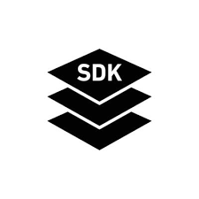


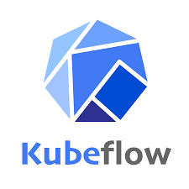





Phoenix
Team Description
The Phoenix development team enhances the Dynamic Soils Hub by integrating Large Language and Statistical Model technologies for soil science and conservation. They develop modeling templates, implement fuzzy logic and neural networks, and create conservation algorithms. Their work spans simulation-based summaries like SOC stock and soilinteractions, along with 3D surface water routing. The team utilizes Dynamic Soil Survey with SSURGO, emphasizing data visualization and graphic design. They handle server provisioning, semantic indexing of assets, and port SoilWeb functionalities. They conduct spatial-temporal analysis, develop visualization templates, and leverage AI/ML for predictive modeling in soil science and conservation planning.
Program Roadmap
Key milestones
Data visualizations (Feb ‘25)
Publishing templates (Mar ‘25)
Fuzzy Logic improvements (Mar ‘25)
Conservation algorithms (Jun ‘25)
Critical deliverables
Integration of statistical technologies
Data visualizations, templates and design
Publishing templates
Conservation Algorithms
PI28:
Oct ‘24 – Jan ‘25
PI29:
Jan – Apr ’25
PI30:
Apr – Jul ‘25
Technology
Notes:
Fun Fact – Phoenix Name - Phoenix - the first warp drive flight by Zephram Cochrane (cue Steppenwolf)

Slide 35





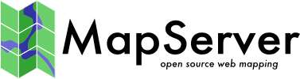

Sea Shadow
Team Description
The Sea Shadow team will work within the Dynamic Soils Hub environment, focuses on providing robust spatial services and data delivery through its API Generation and Builder. It supports publishing templates, using Map server and/or geoserver and WMS, facilitating efficient app development and integration with WCS and S3 repositories.
Program Roadmap
Key milestones
Implement Map server with flows (Mar ‘25)
Integrate with WCS and S3 repositories. (Feb ‘25)
Data Delivery (Feb ‘25)
Big Data Processing (Jun ’25)
Critical deliverables
Develop robust spatial services.
Enhance API Generation and Builder.
Implement Map server and/or Geoserver with WMS.
Integrate with WCS and S3 repositories.
Data Delivery
PI28: Foundational Analysis
Oct ‘24 – Jan ‘25
PI29: Automation and Integration
Jan – Apr ’25
PI30: Self Service Delivery
Apr – Jul ‘25
Technology
Notes:
Fun Fact – Sea Shadow name - Sea Shadow (IX-529) was an experimental stealth ship built by Lockheed Skunkworks for the United States Navy to determine how a low radar profile might be achieved and to test high stability hull configurations that have been used in oceanographic ships.

Slide 36
Sea Shadow | Apollo Integration Points
Albacore
Horizon
Sea Shadow
Seawolf
Artemis
Apollo
Ceres Tiger Team
Phoenix
Apollo/SEA Integration Patterns
Data delivery workflow integration
Permissions synchronization
Delivery status tracking
Metadata validation flow
GDA compliance checks
Inputs from Apollo | Outputs to Apollo
Workflow status updates | Delivery status notifications
Approval state changes | S3 access configurations
Metadata requirements | Delivery metrics
Access control policies | Pipeline execution status
Release approvals | Data availability updates
DevOps
Best Practices

Slide 37
Sea Shadow | Albacore Integration Points
Albacore
Horizon
Sea Shadow
Seawolf
Artemis
Apollo
Ceres Tiger Team
Phoenix
Albacore/SEA Integration Patterns
Infrastructure alignment
Security framework integration
DevOps pipeline synchronization
Monitoring integration
Deployment coordination
Inputs from Albacore | Outputs to Albacore
Infrastructure patterns | Resource utilization support/metrics
Security requirements via SEAT/Platform team | Security compliance data
Deployment configurations | Infrastructure status
Monitoring setup (e.g. splunk) | Performance metrics
Performance baselines | Deployment feedback
DevOps
Best Practices

Slide 38
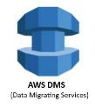


Albacore
Team Description
The Albacore Dev Team is a shared service team within the Dynamic Soils Hub Environment. They handle database systems engineering and configuration, including GIS DevOps, ensuring robust and secure operations. The team adheres to Security Technical Implementation Guides (STIG) and manages the roadmap for the NPAD Data Pipeline and Switchboard. Their responsibilities encompass database systems operations and engineering, implementing best practices, and deploying DevOps solutions and automations. This includes creating DevOps deployment dashboards and big data automations, as well as providing architectural recommendations and coordinating with architecture experts and leads to ensure seamless integration and optimal performance.
Program Roadmap
Key milestones
Release Management Flow (Dec 16 ‘24)
ML Infrastructure Framework (Jan 13 ’25)
Security Framework Complete (Apr 7 ‘25)
Critical deliverables
Dev Sec Ops Standardization
Security Implementation
ML Infrastructure Framework
PI28: DevOps + Infrastructure
Oct ‘24 – Jan ‘25
PI29: Security + ML Infrastructure
Jan – Apr ’25
PI30: Production Infrastructure
Apr – Jul ‘25
Technology
Notes:
Fun Fact: Albacore name - Fastest submarines - the revolutionary design was derived from extensive hydrodynamic and wind tunnel testing, with an emphasis on underwater speed and maneuverability

Slide 39


Ceres Tiger Team
Team Description
This will be a small team that integrates with Seawolf and GIS1 team on the geospatial services for the data catalog and metadata work, but that also acts as a support team for all the Hub teams.
Program Roadmap
Key milestones
Start data evaluation of existing service inventory datasets to develop road map for continued data quality evaluation tasks
Critical Deliverables
PI28: Analysis of geospatial services integration into GDA Data Catalog
Oct ‘24 – Jan ’25
Technology
Notes:
Fun Fact – Ceres Name - Ceres is the goddess of agriculture and the harvest in Roman mythology

Slide 40
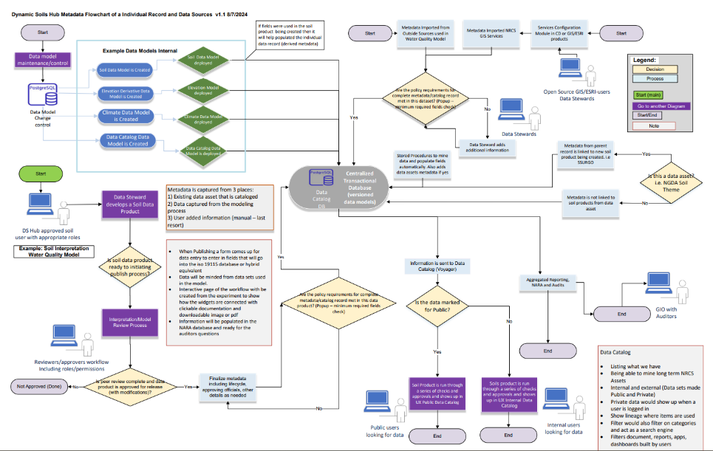
Meta Data Flow
Notes:
This sorted list provides another perspective on how each team contributes to building a revolutionary platform that transforms soil data management and conservation planning, block by block.

Slide 41
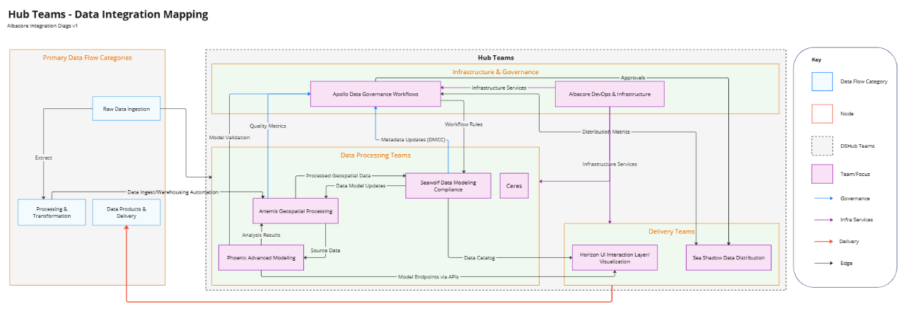
Data/Governance Integration Map
Notes:
This sorted list provides another perspective on how each team contributes to building a revolutionary platform that transforms soil data management and conservation planning, block by block.

Slide 42
Thank You!

